Slide 1
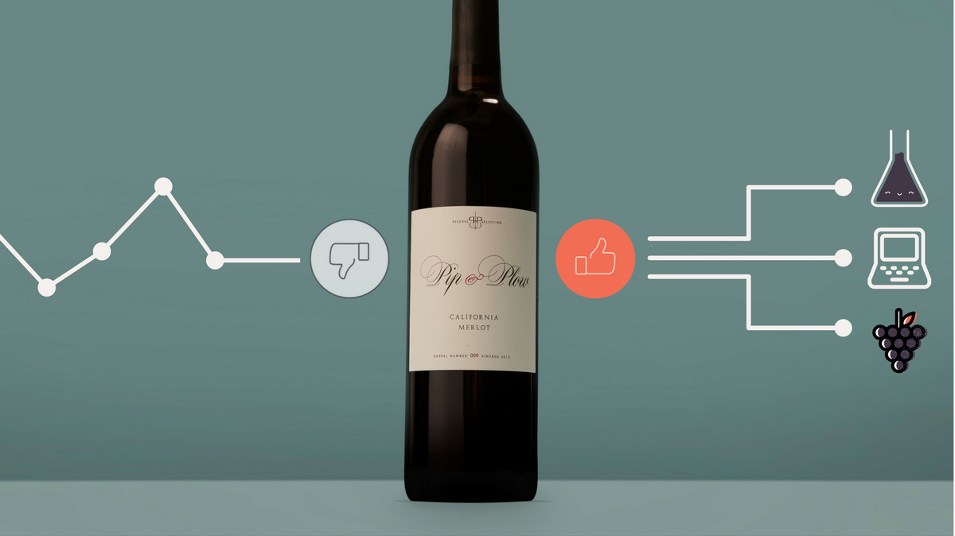
Grupo 1:
Cintia Mercado
Mariana Revilla
Eduardo Garza
Agosto 8, 2020

Slide 2
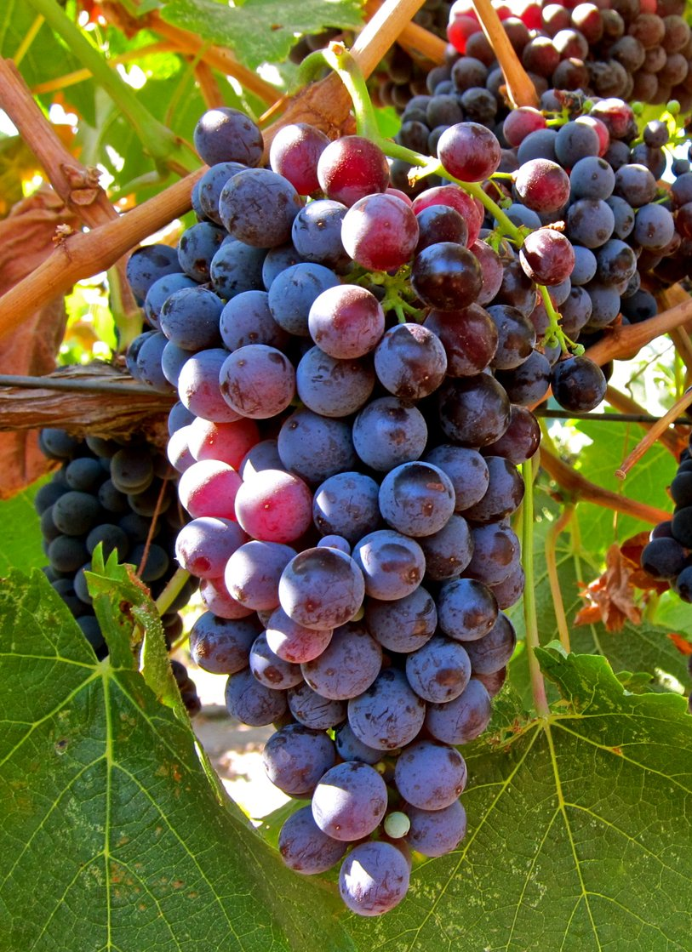
Can we predict the price of wine?
What factors influence pricing?
Can we determine if we are getting a good deal for our money when purchasing a bottle of wine?

Slide 3

Data Set
Open Data @ Kaggle.com
150,930 records:
Wine
Country
Description
Grading (points)
Price
Province
Region_1
Region_2
Grape variety
Winery

Slide 4
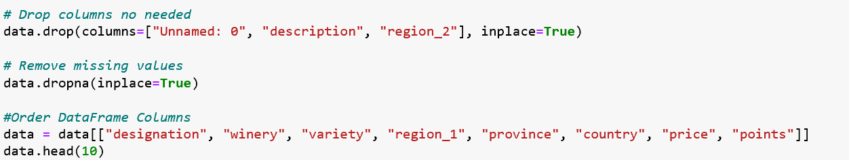
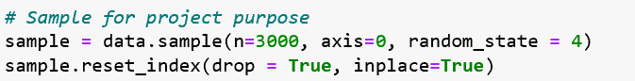
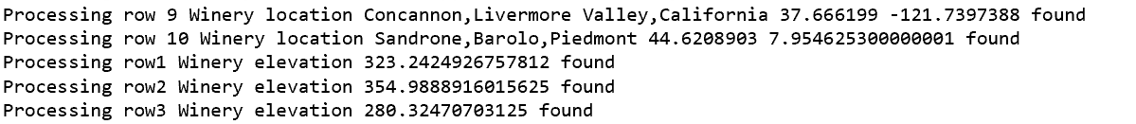
Our Sample
Data Cleansing
Dropped ID, description, region_2
Dropped NaNs
Re-ordered DataFrame
Sampling
3000 random records
Georeferencing sampling
Latitude and Longitude (geocode.api)
With coordinates obtain altitude (elevation.api)

Slide 5
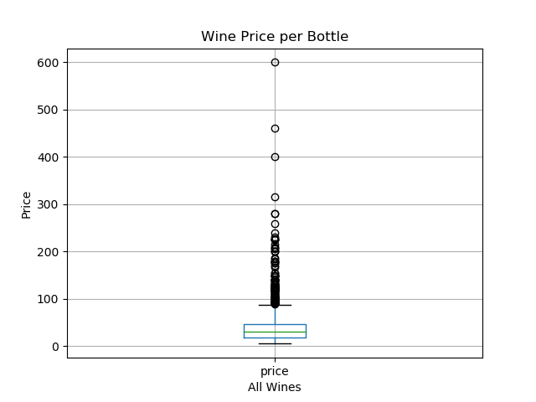
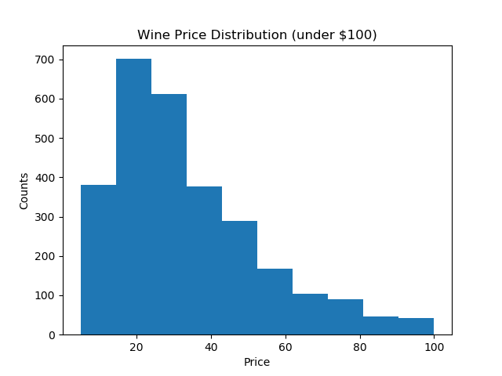
Our Sample
Sample Cleansing
Dropped records with no Latitude, Longitude or Altitude (88 -> 2,912)
Dropped “Canada” due to low number of observations (3 -> 2909)
Focused on wines under $100usd (100 -> 2,809)
The lower quartile of price is: 18.0
The upper quartile of price is: 46.0
The interquartile range of price is: 28.0
The the median of price is: 30.0
Values below -24.0 could be outliers. (zero)
Values above 88.0 could be outliers.
Final Sample
2,809 wines
1,791 wineries
172 varieties of wine
6 countries
48 provinces

Slide 6
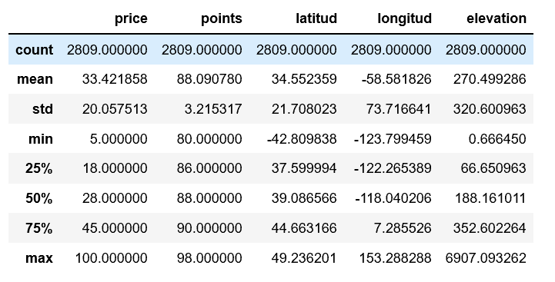

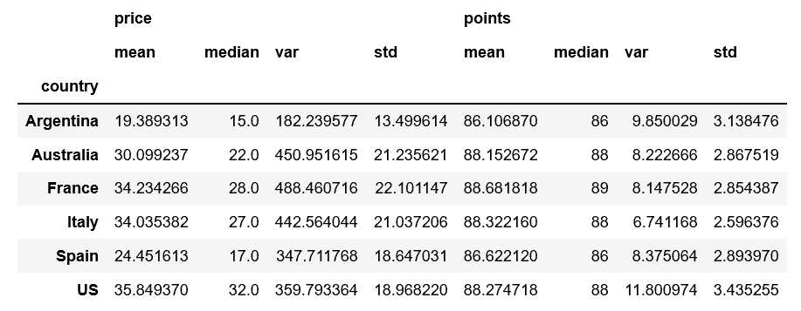
Sample Description
Price and Rating Statistics Grouped by Country
Price seems to have a significant amount of variation per country

Slide 7
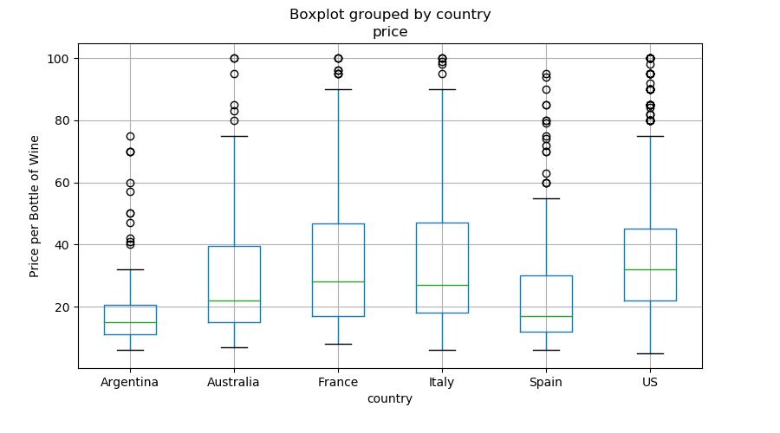
F_onewayResult(statistic=28.128659369780202,
pvalue=6.700349494424998e-28)
The ANOVA demonstrates “Prices per Country” are independent groups

Slide 8
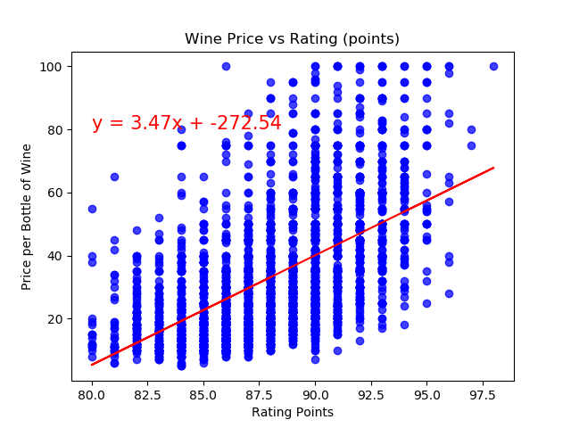


The correlation between both factors is 0.56
The r-squared is: 0.31001201962230474
Moderate and positive correlation for prices and rating (points)
Does it mean that prices are higher for better tasting wines? or are we prone to be more easygoing when rating more expensive wines?

Slide 9
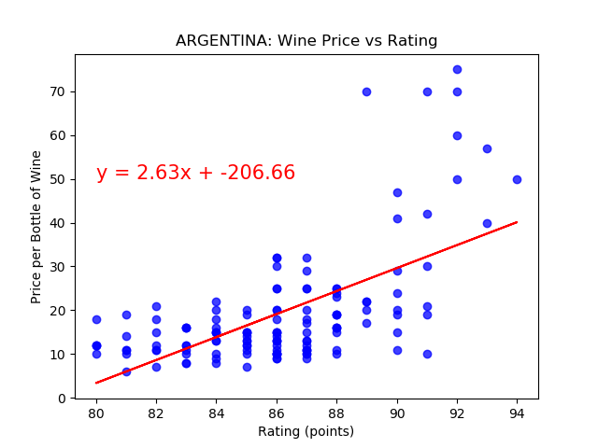
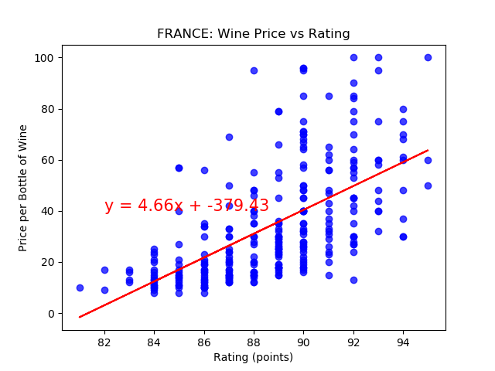
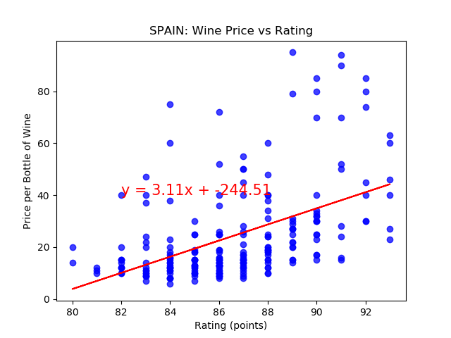
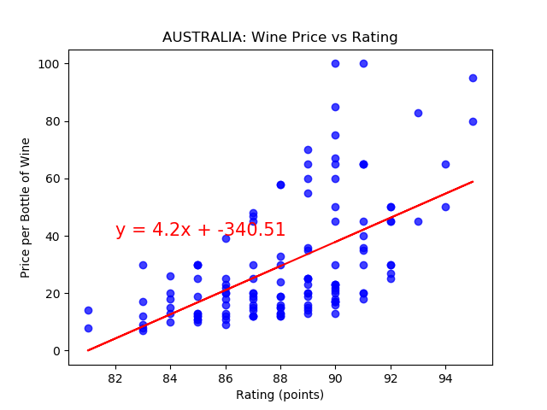
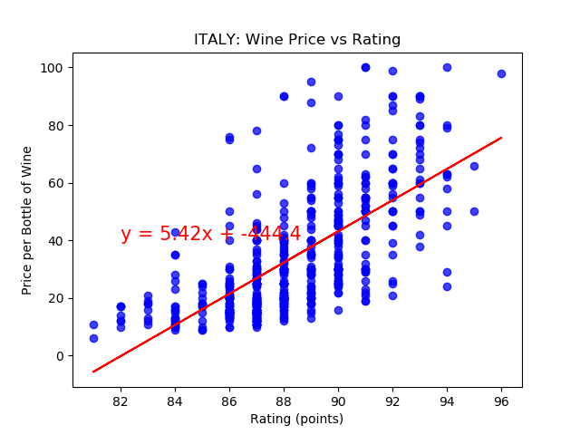
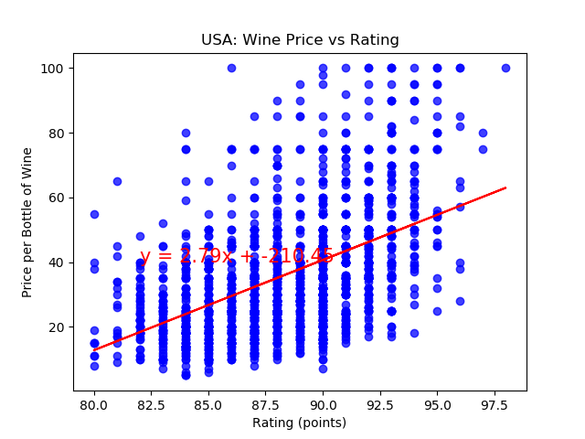
Same relationship of price and rating in every country
The correlation between both factors is 0.61
The r-squared is: 0.3724878603227943
The correlation between both factors is 0.6
The r-squared is: 0.3629254372526378
The correlation between both factors is 0.48
The r-squared is: 0.23221956621624312
The correlation between both factors is 0.57
The r-squared is: 0.3222847769928225
The correlation between both factors is 0.67
The r-squared is: 0.44695987199960985
The correlation between both factors is 0.51
The r-squared is: 0.2553412894715367

Slide 10
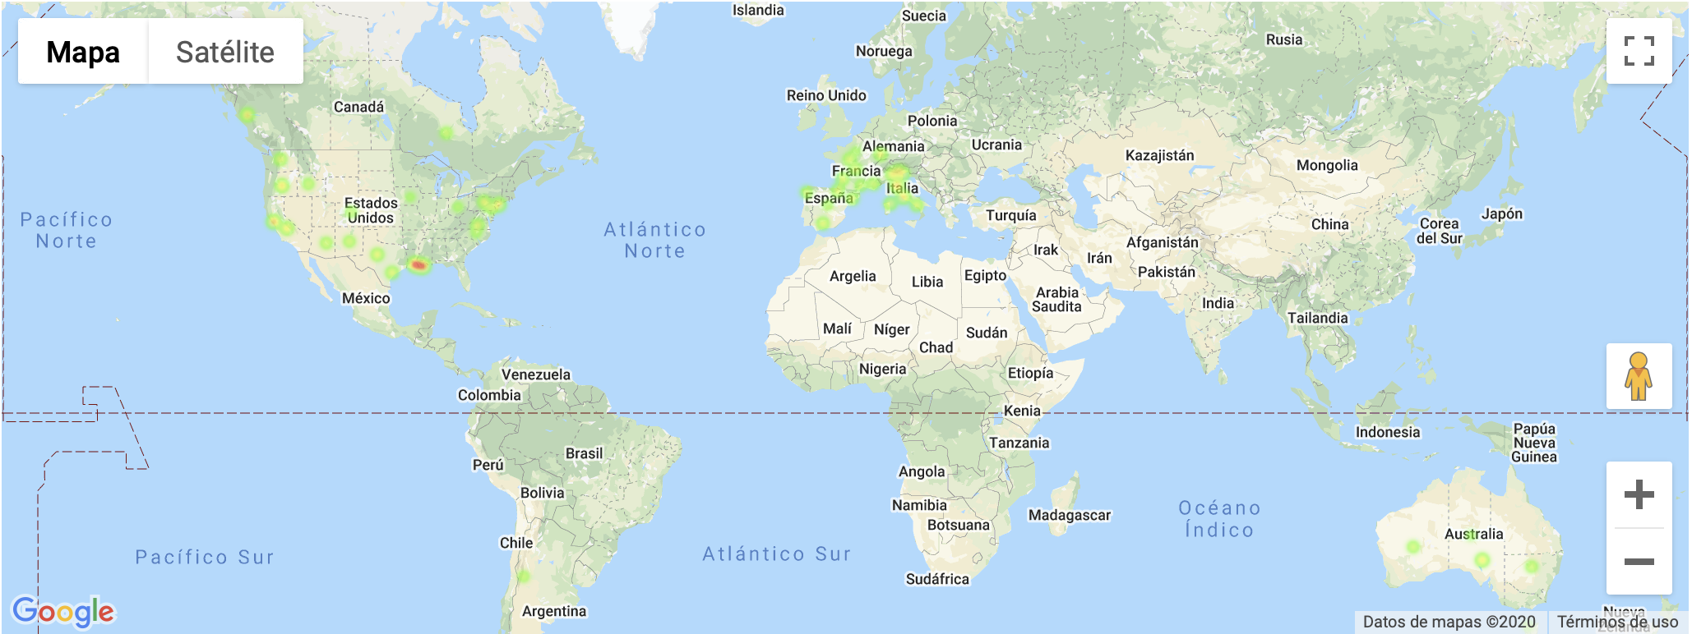
Heat Map for Wine Prices by Province, Country

Slide 11
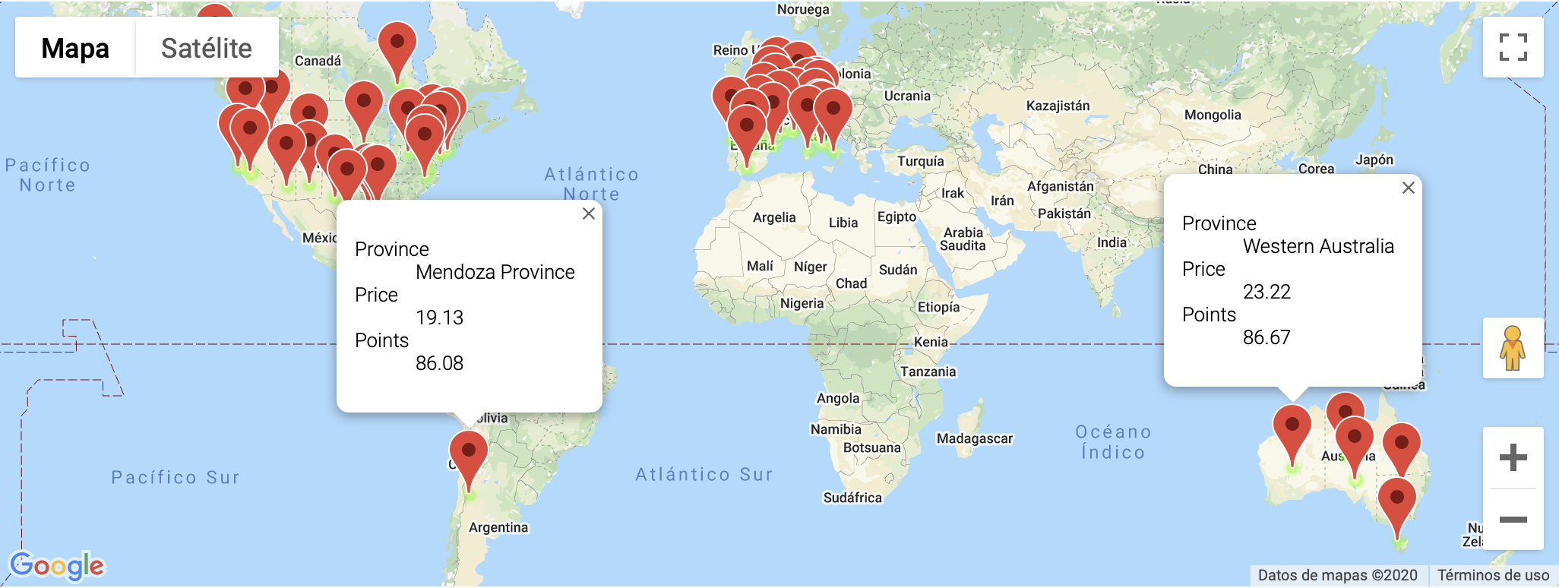
Markers for Wine Prices by Province, Country

Slide 12
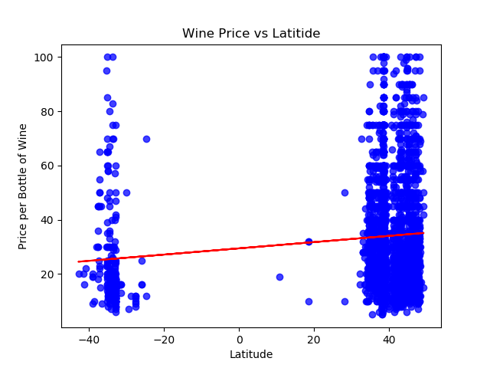
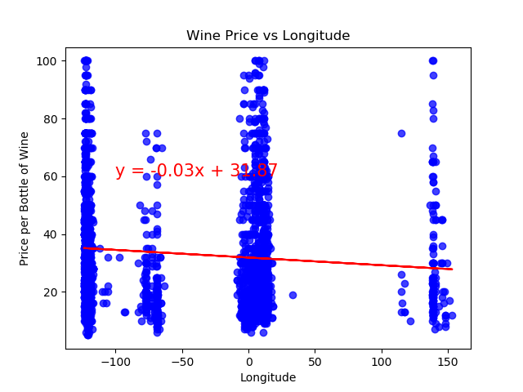
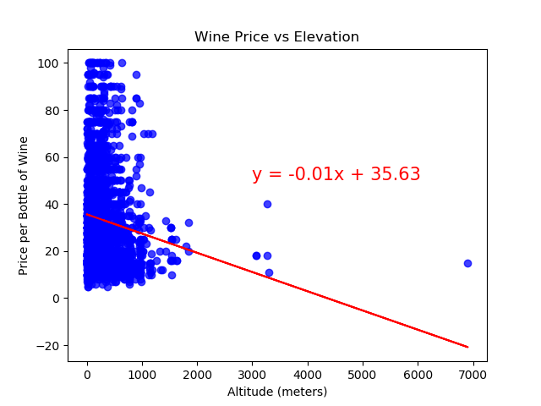
Latitude, Longitude and Elevation do not seem to be explanatory variables for wine pricing
The correlation between both factors is 0.12
The r-squared is: 0.015506105074422814
The correlation between both factors is -0.1
The r-squared is: 0.009471488415690064
The correlation between both factors is -0.13
The r-squared is: 0.01709064379223488

Slide 13
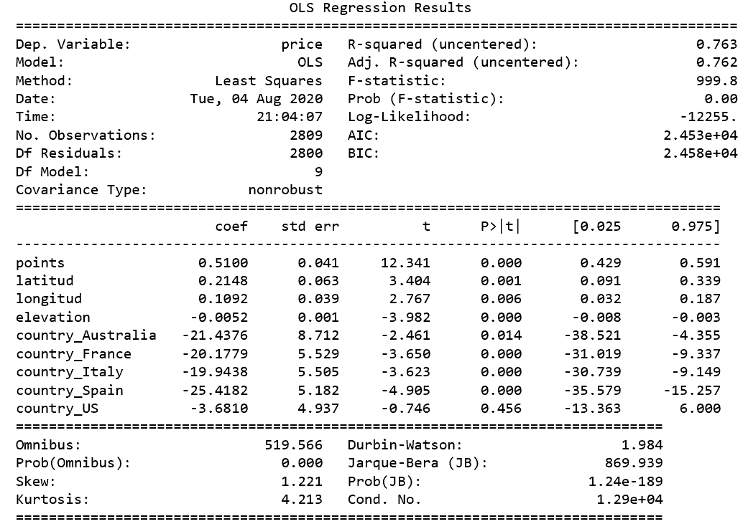
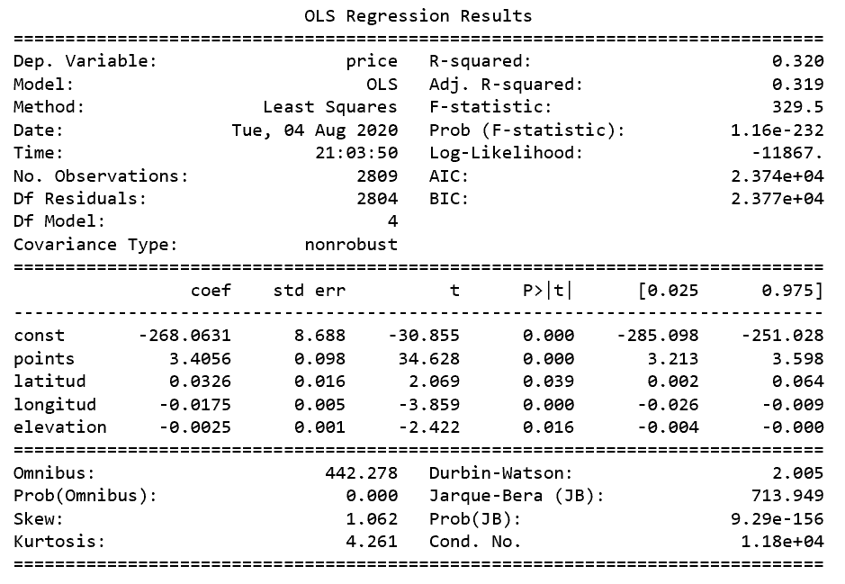
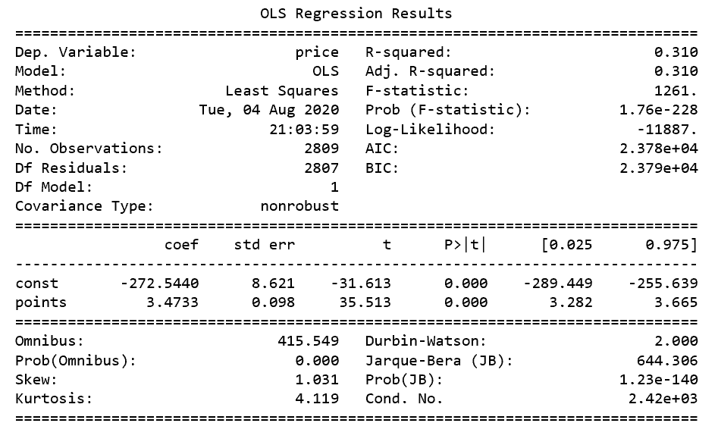
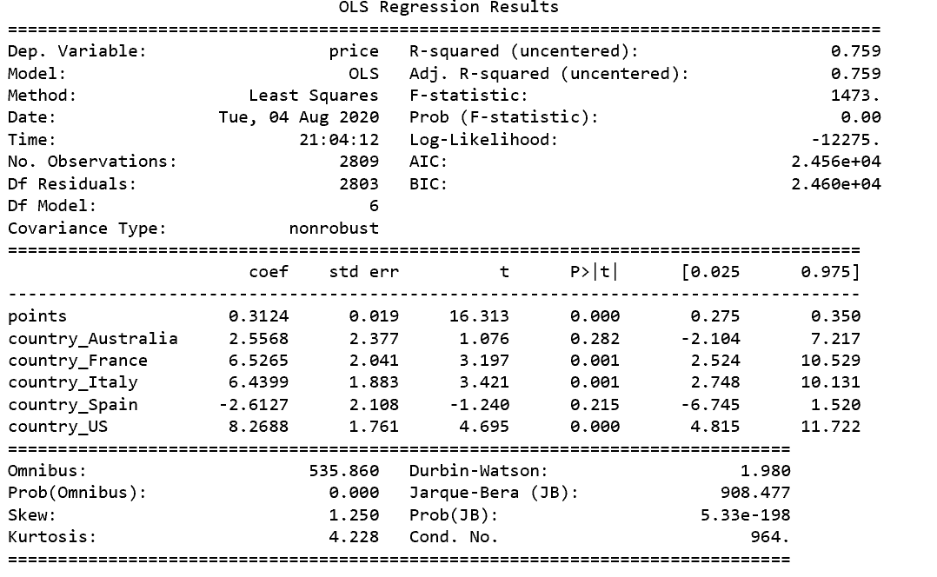
Regression Models
Model 1
Model 3
[1] Std errors assume covariance matrix of errors is correctly specified
[2] Strong Multicollinearity
[1] Std errors assume covariance matrix of errors is correctly specified
[2] Strong Multicollinearity
Model 2
Model 4
[1] Std errors assume covariance matrix of errors is correctly specified
[2] Strong Multicollinearity
[1] Std errors assume covariance matrix of errors is correctly specified

Slide 14
Testing Data Set
Test Sample
1000 random records from same dataset
Georeferencing sampling
Latitude and Longitude (geocode.api)
With coordinates obtain altitude (elevation.api)
Sample Cleansing
Dropped records with no Latitude, Longitude or Altitude (30 -> 970)
Dropped “Canada” (5 -> 965)
Only wines under $100usd (14 -> 936)

Slide 15
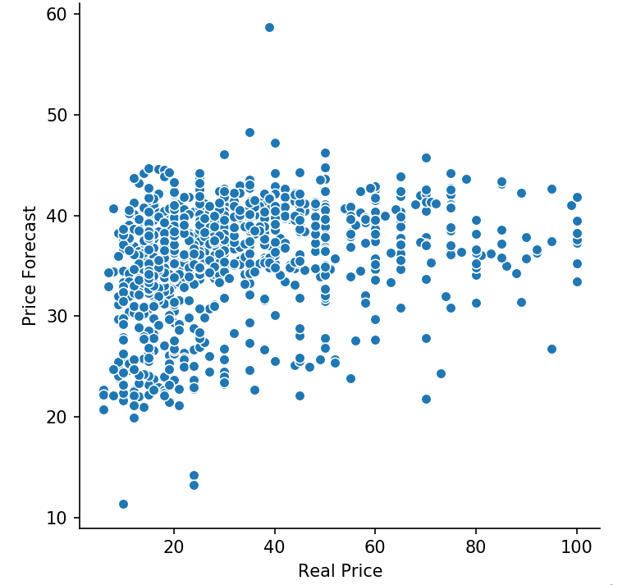
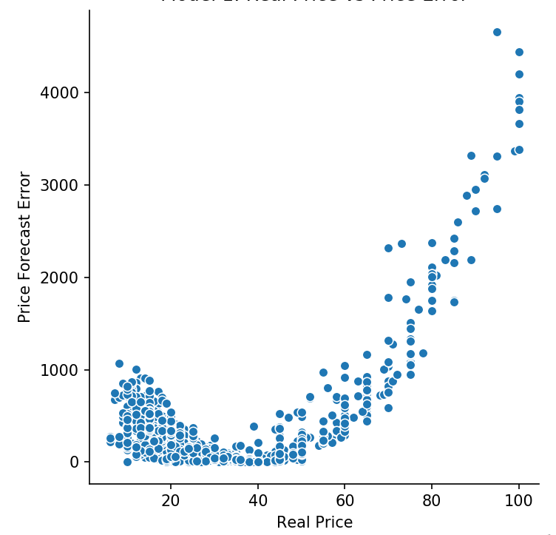
Model 1 Testing Results
Error as X2
Price Forecast = 0.51(Points) + .2148(Latitude) + .1092(Longitude) - (.0052)(Elevation) - (21.4376)(Australia) - (20.1779)(France) - (19.9438)(Italy) + (25.4182)(Spain)
MSE = 368.09077103952404
RMSE = +- 19.1856918311413

Slide 16
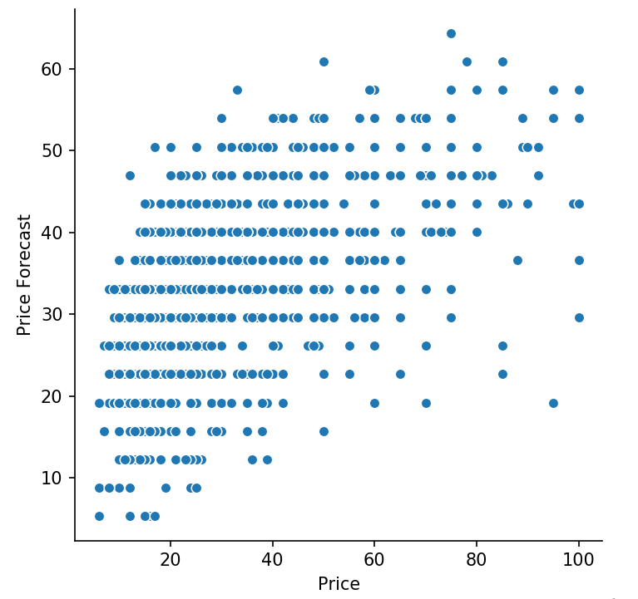
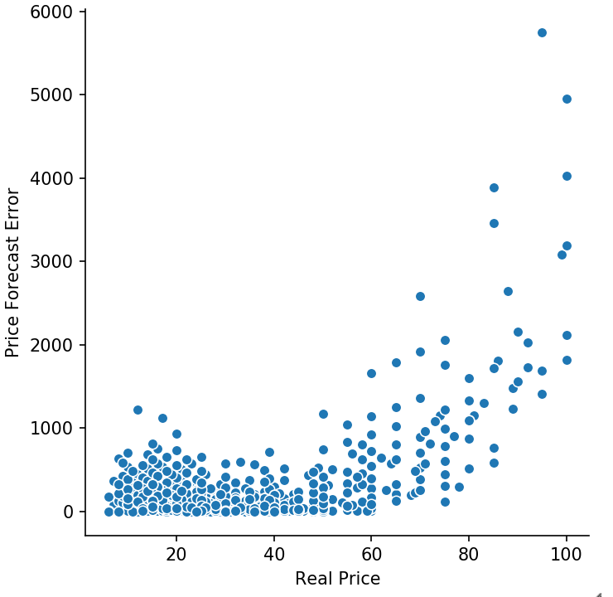
Model 2 Testing Results
Error as X2
MSE = 274.20792466784167
RMSE = +- 16.559224760472382
Price Forecast = -268.0631 + 3.4056(Points)

Slide 17
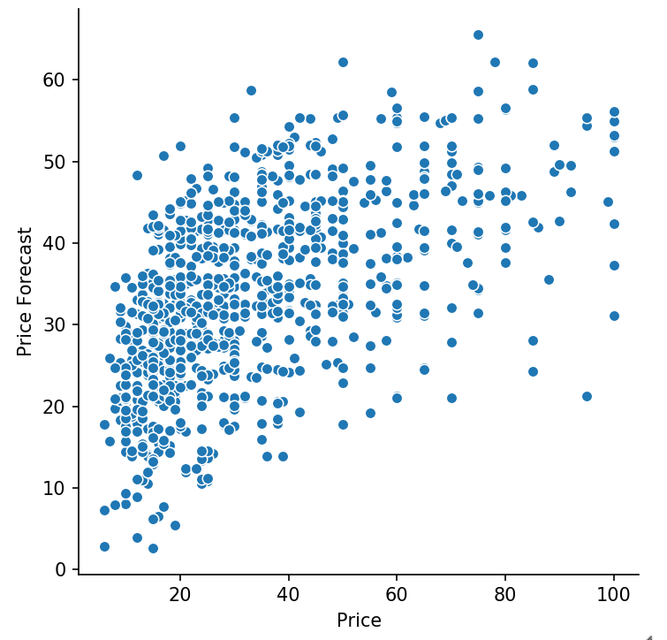
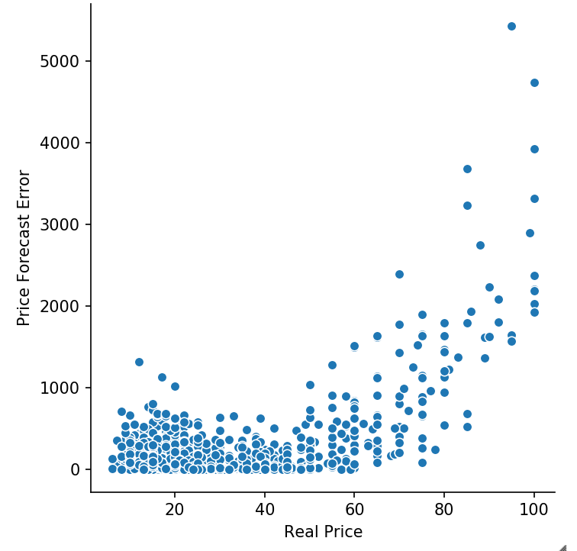
Model 3 Testing Results
Error as X2
Price Forecast = -268.0631 + 3.4056(Points) + .0326(Latitude) - (.0175)(Longitude) - (.0025)(Elevation)
MSE = 271.8739375731748
RMSE = +- 16.48860023086177

Slide 18
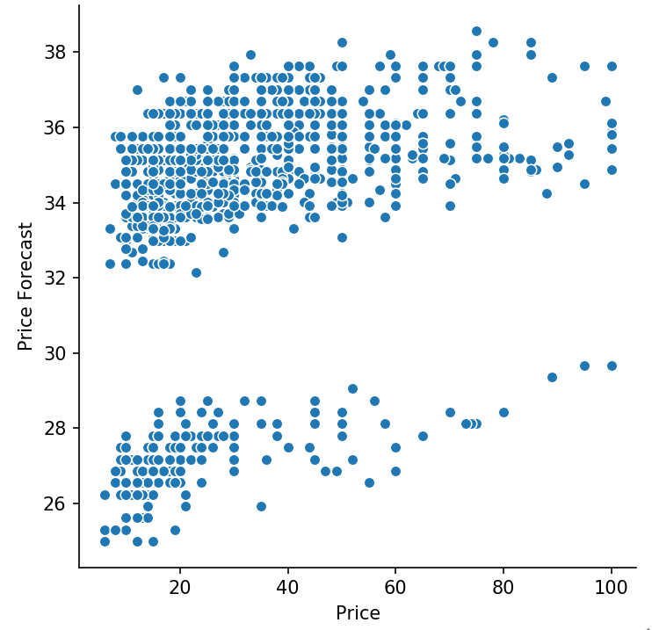
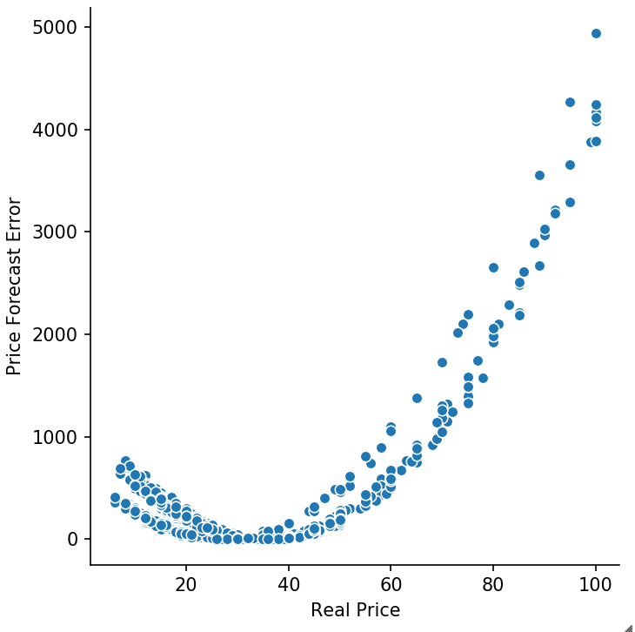
Model 4 Testing Results
Error as X2
Price Forecast = 0.3124(Points) + 6.5265(France) + 6.4399(Italy) + 8.2688(US)
MSE = 362.7593081679807
RMSE = +- 19.04624131339254

Slide 19
Conclusions
Overall, the models are more accurate for wine bottles priced between $20 and $60.
Model 4 can be adjusted for better fit. It also depicts two price clusters: 1) High price wines: USA, Italy and France and 2) Low Price wines: Argentina, Australia and Spain.
A larger sample data set could result in a more promising model. Our sample was limited due to budget constraints.
Wine tasting ‘ratings’ seems to be an important contributor to wine prices. Future research could establish if better ratings contribute to higher prices or if higher prices contribute to better ratings. Regardless, wine producers need to pay close attention to reviews. On the other hand, wine consumers can rely on ratings when purchasing wine but keeping in mind that there are diminishing returns as the price continues to increase.
Other factors not considered in our study should be observed to have a more solid model, as for example: grape variety, harvest year, winery years of operation as well as weather variables per region like rain per year and temperature.
Even though the wine market is considered as a global market, our research shows prices per country are independent, maybe influenced by local market dynamics. Thus, pricing models per country could be done at later stage.
Future research could be done by reframing the question as what is the probability this is a good wine? Using a log regression and factors such as price, ratings, country of origin, etc. could give us a probability of success.
As there are diminishing returns for taste rating, another approach could be to use an optimization model that seeks to maximize rating while minimizing price to pursue best value deals.

Slide 20

Grupo 1:
Cintia Mercado
Mariana Revilla
Eduardo Garza
Agosto 8, 2020

